Slide 1

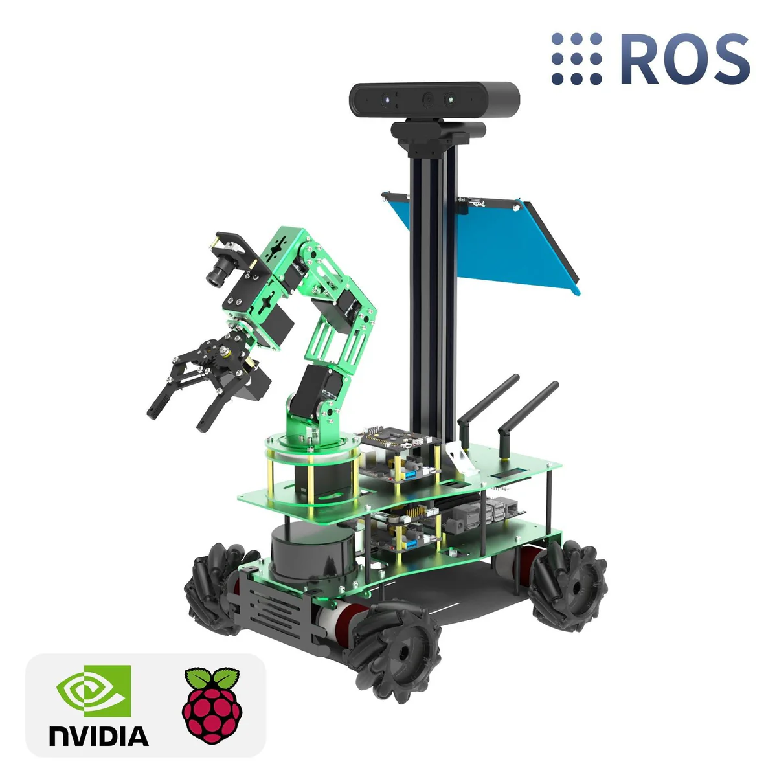

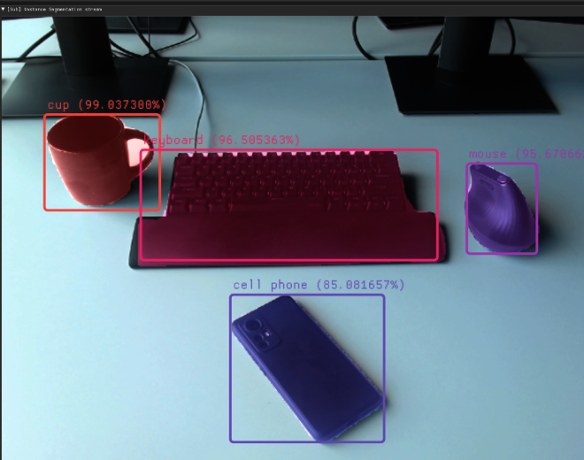
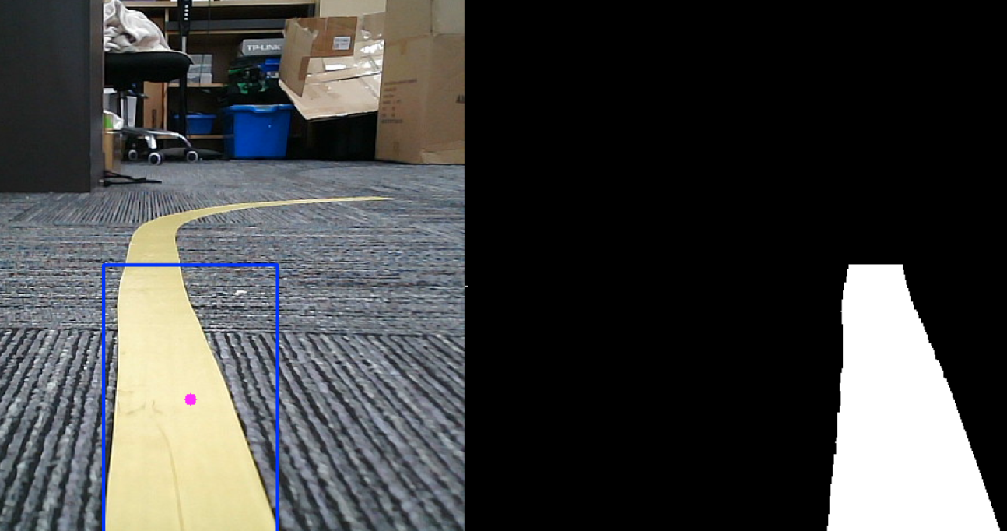
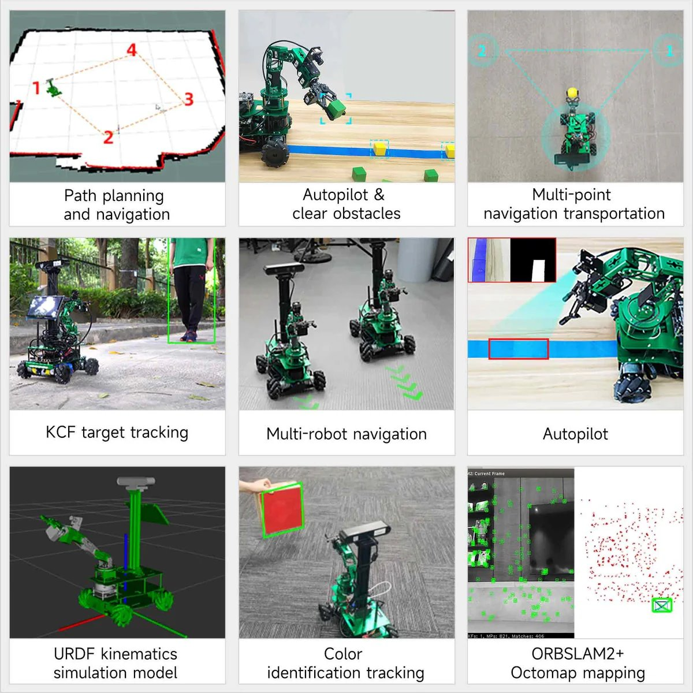
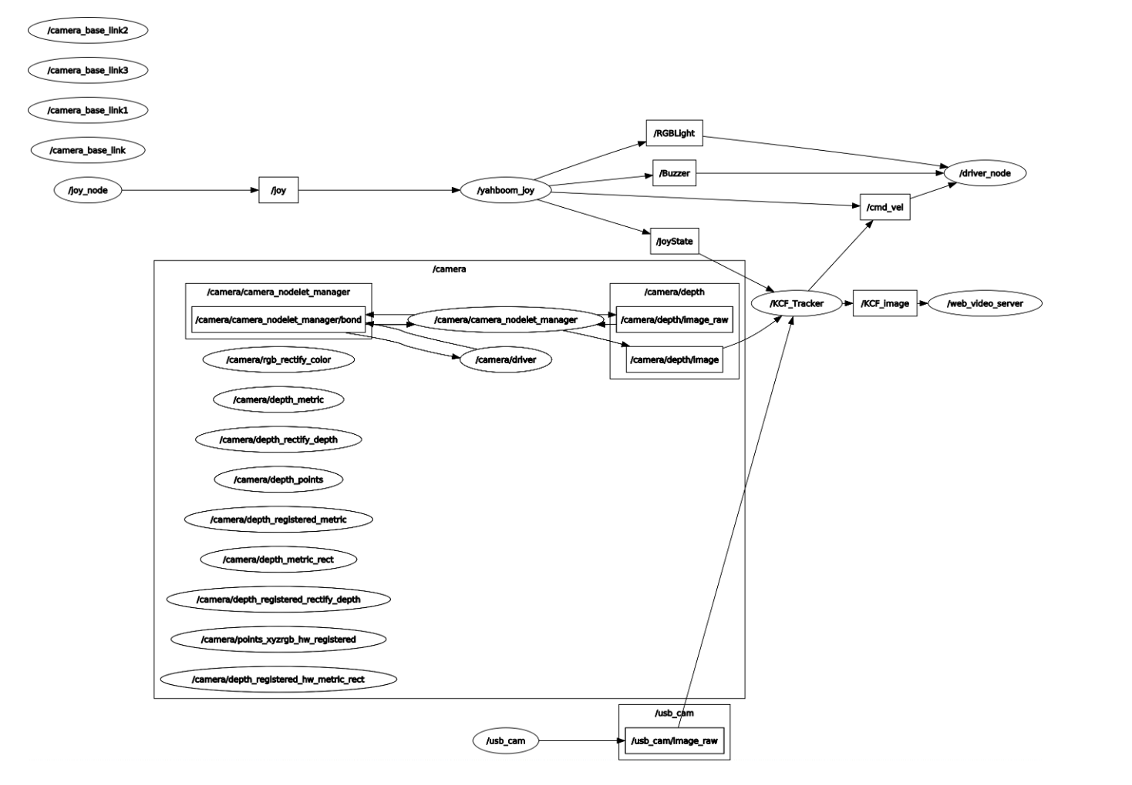
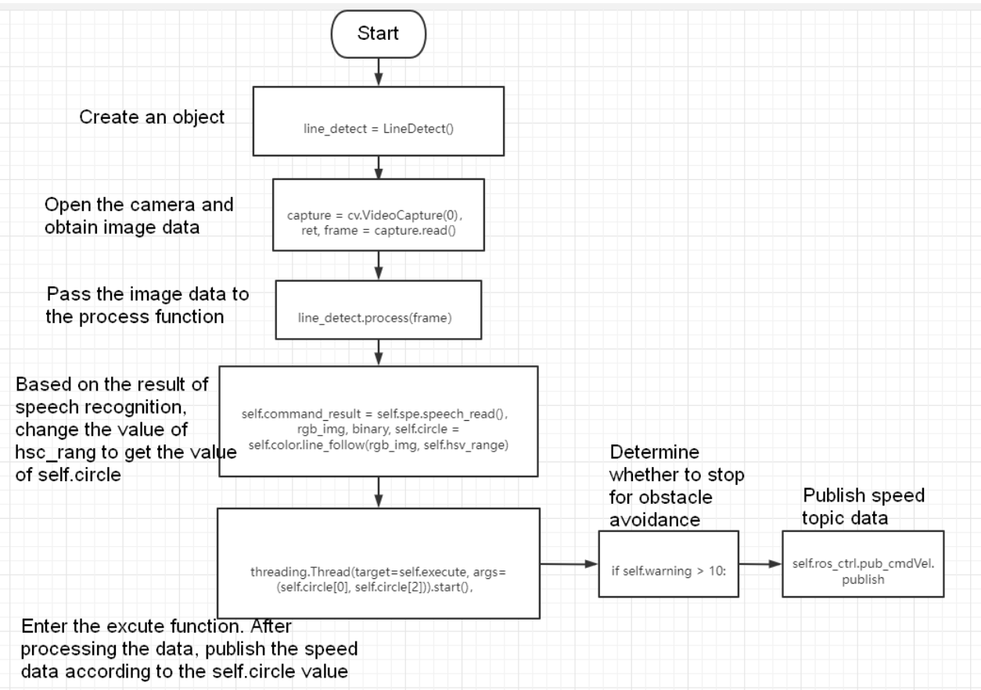

Revolutionizing Laboratory Automation with AI: Advancements in Computer Vision and Voice Commands
UG students: Tibian Elsheikh, Omar Mian
Mentor: Jeremy Reed
Faculty Advisor: Dr. Turgay Korkmaz
Computer Science, The University of Texas at San Antonio
Introduction
Nvidia Jetson Nano) for real-time processing.
Achievements in Computer Vision
Voice Commands for Hands-Free Control
Future Vision
Laboratory research often faces inefficiencies due to manual tasks like sample collection and data processing. Our project seeks to revolutionize scientific laboratories by integrating AI-driven robotics. By leveraging computer vision and voice recognition, we aim to enhance laboratory workflows, improve accuracy, and accelerate research. This poster highlights our progress in computer vision and voice commands, as well as the exciting possibilities these technologies bring to lab automation.
In the realm of computer vision, we have successfully utilized the YOLO (You Only Look Once) algorithm for various object detection using camera feeds (phone, laptop, person, etc) This achievement has laid the groundwork for the following future innovations:
Multi-Object Tracking
Our next goal is to implement multi-object tracking capabilities that will allow our systems to monitor several items simultaneously. This will be particularly useful in experiments involving multiple samples or subjects.
Enhanced Image Processing
We plan to improve our image processing techniques to include advanced features such as anomaly detection and pattern recognition. This will enable our lab to identify unexpected results or outliers in experimental data more effectively.
Current Progress
We have successfully implemented voice recognition technology to detect colors (red, blue, yellow), allowing our robotic systems to respond to verbal commands by navigating towards specified colors. This foundational work sets the stage for the following exciting future developments.
Expanded Command Vocabulary
We plan to enhance our voice recognition capabilities by expanding the range of commands that can be processed. This will enable more complex interactions, such as instructing robots to perform specific tasks based on color detection.
Integration with Laboratory Equipment
Future efforts will focus on integrating voice commands with various laboratory instruments, allowing researchers to control equipment hands-free, thus improving efficiency and safety in lab environments.
Applications in Laboratory Automation
The integration of computer vision and voice commands opens up exciting possibilities for lab automation, such as:
Accelerating data collection and analysis by automating repetitive tasks.
Improving accuracy by reducing human errors in experiments.
Streamlining workflows to allow researchers to focus on critical tasks instead of manual labor.
Conclusion
Our work demonstrates significant progress in integrating AI technologies into scientific laboratories. Our achievements in color detection, object recognition, and voice-based navigation illustrate the potential of AI-driven robotics to transform research environments.
Project Goals
The primary goal of our project is to revolutionize scientific laboratories by integrating artificial intelligence and robotics into their daily operations. We aim to transform traditional workflows into automated, efficient systems capable of handling tasks such as:
Sample Collection
Automating the handling and storage of samples to ensure consistency and reduce contamination risks.
Data Sampling and Analysis
Enabling real-time data collection and processing through AI-powered algorithms to accelerate experimental timelines.
Human-Robot Interaction
Developing robots that can respond to voice commands and interpret visual data, bridging the gap between human researchers and automated systems.
Acknowledgement: This material is based upon work supported by the U.S. Department of Energy, Office of Science, Office of Advanced Scientific Computing Research (ASCR), Reaching a New Energy Sciences Workforce (RENEW) under Award Number DE-SC0024322.
Reference 1. Yahboom, "Rosmaster X3 Plus Documentation," Yahboom Official Website. [Online]. Available: https://www.yahboom.net. [Accessed: Jan. 27, 2025]

